Slide 1

REJUVENATING THE CENTRE
AGM UPDATE, FEBRUARY 2025
MAKING SOUTH BRENT OLD SCHOOL COMMUNITY CENTRE WARM, DRY & WELCOMING FOR THE NEXT 150 YEARS
Introduction and update | 40 mins
Over to you: Questions, queries and next steps | 20 mins
Food, chat and your help in raising the funds | 30 mins
AGM | 30 mins

Slide 2
OUR STORY
Opened in 1876 as the South Brent
Board School
Acquired and reopened as a
Community Centre in 1997
2026 marks 150 years at the heart of
the South Brent Community
Time for rejuvenation for the
next 150 years

Slide 3
OUR CHARITABLE WORK
We are a charity and work entirely for public benefit and not for profit. Two main aims:
Education and social welfare for all – in the centre, in partnership and elsewhere
Establish and run a Community Centre
Led by trustees and supported by
Michelle, our Centre Manager

Slide 4

Facilities
Services
Activities
Partnerships

Slide 5
REJUVENATING THE CENTRE
THE CHALLENGES
An aging roof with increasing damage
Inefficient heating and insulation
Lack of space but also some underused space
Poor quality of some space

Slide 6
REJUVENATING THE CENTRE
THE CONSULTATION
Ran in Autumn 2024
3 proposals
2 aspirations

Slide 7


Slide 8
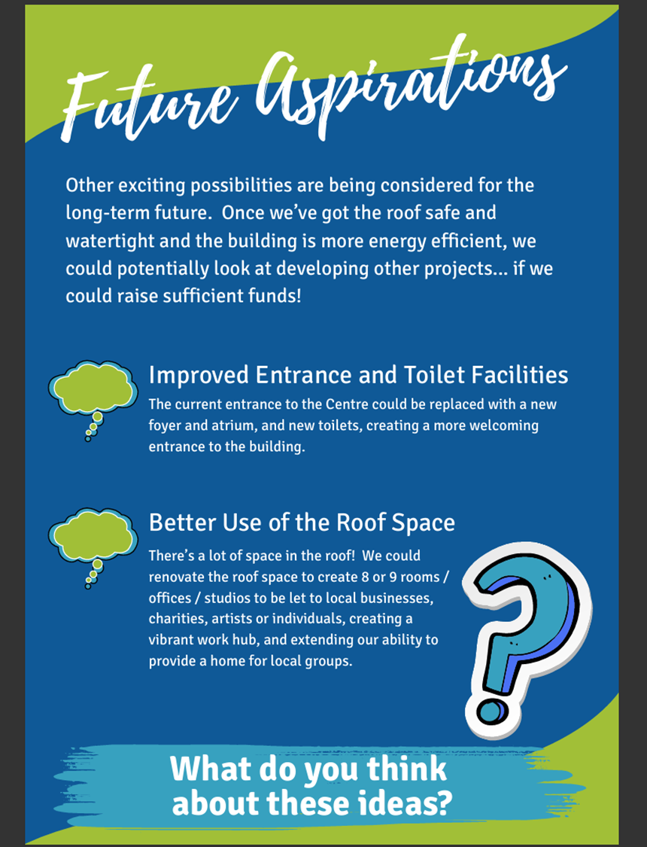

Slide 9
REJUVENATING THE CENTRE
THE CONSULTATION
400 individual responses. 13 organisations.
Broad, deep and thoughtful feedback
Full feedback to come but...

Slide 10
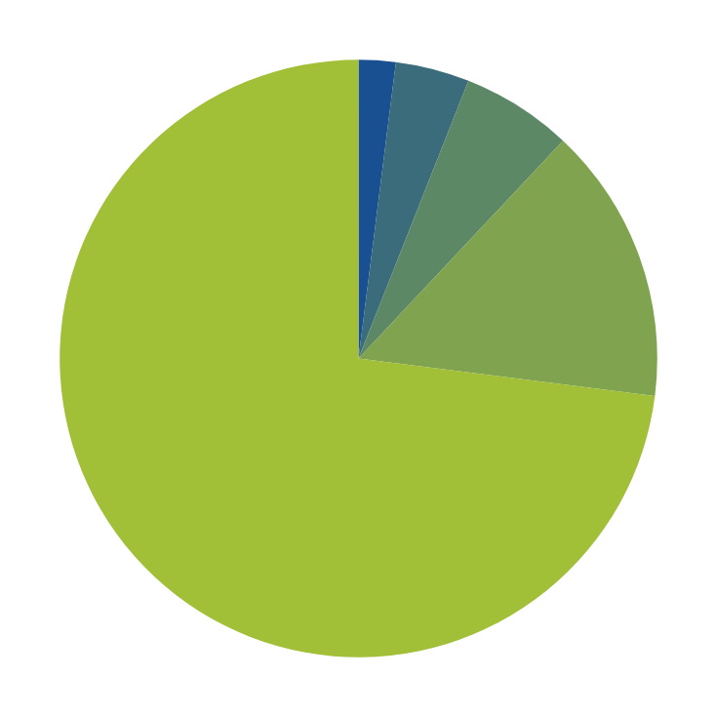
REJUVENATING THE CENTRE
HOW IMPORTANT IS THE CENTRE?
Not important or not important at all
2%
Neutral
4%
No answer
6%
Important
15%
Extremely important
73%

Slide 11
REJUVENATING THE CENTRE
WHAT COULD BE BETTER IN THE CENTRE?
Decor
Youth club
More studios
Toilets
Parking
Better IT/printing facilities
Kitchen
Heating/energy
Roof
Library always
open
Gym
Parents and babies
Entrance
More space

Slide 12
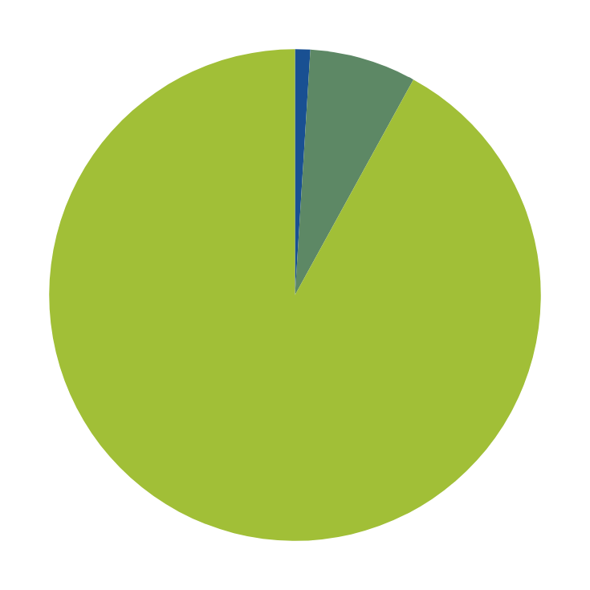
REJUVENATING THE CENTRE
SHOULD WE REPLACE THE ROOF?
No
1%
Don’t know
7%
Yes
92%

Slide 13

REJUVENATING THE CENTRE
SHOULD WE INSTALL SOLAR PANELS?
No
1%
Don’t know/
no answer
6%
Yes
93%

Slide 14
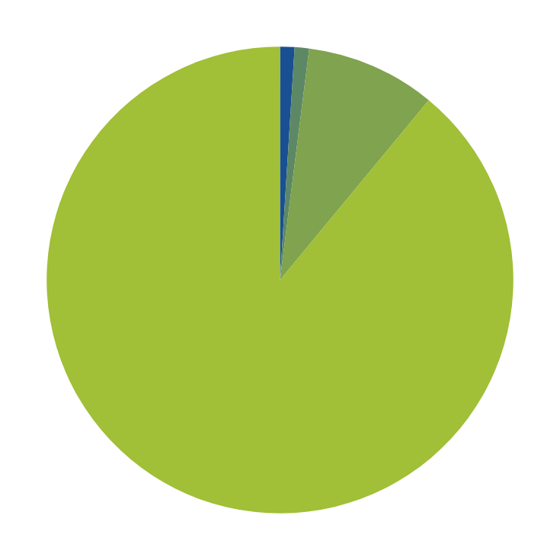
REJUVENATING THE CENTRE
SHOULD WE UPGRADE HEATING & ENERGY?
No
1%
Don’t know
1%
No answer
9%
Yes
89%

Slide 15
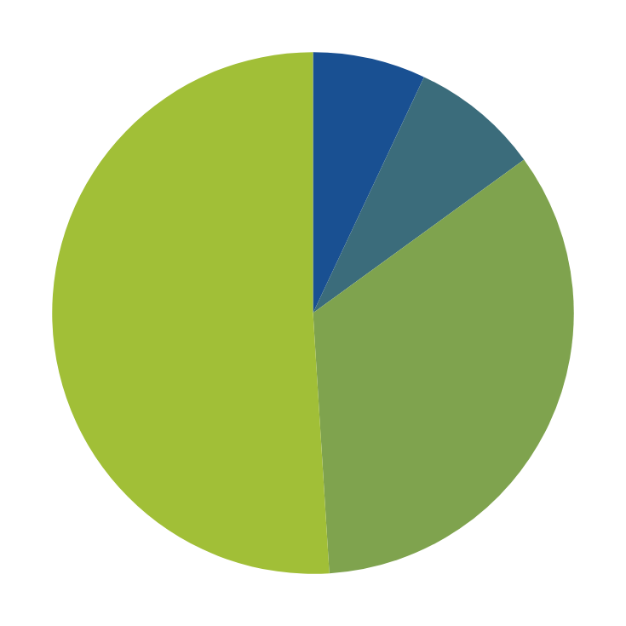
REJUVENATING THE CENTRE
SHOULD WE IMPROVE ENTRANCE & TOILETS?
Disagree/strongly disagree
7%
No answer
8%
Agree/
strongly agree
51%
Neutral
34%

Slide 16
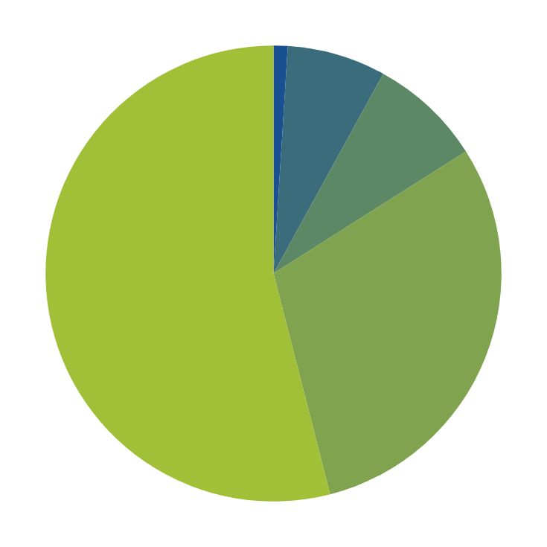
REJUVENATING THE CENTRE
SHOULD WE CREATE MORE SPACE IN THE ROOF?
Don’t know
1%
Disagree/strongly disagree
7%
No answer
8%
Agree/
strongly agree
54%
Neutral
30%

Slide 17
REJUVENATING THE CENTRE
KEY ORGANISATIONS
South Brent and District Caring
Art House
South Brent Storytellers and Archive
Library
Sustainable South Brent

Slide 18
REJUVENATING THE CENTRE
PRIORITIES AND OPPORTUNITIES
Priority 1
Replacing the roof and installing solar
Priority 2
Internal energy and heating
Refurbishing existing space and facilities
Exploring aspirations
Creating more space. Up or out.

Slide 19
RAISING THE ROOF
Replace & repair timbers, strengthen where needed
Replace/reuse slates
Fully insulated – potentially new ceilings creating upstairs floors for future use – a double win
Maximum solar electricity generation
Energy storage in batteries

Slide 20
ENERGY AND HEATING
A fabric first approach
Energy efficiency measures: insulation, windows, wall and floors
New heating: air source heat pumps/electric heating
Could be room by room approach and/or
phased over time
Could be a gradual transition off gas

Slide 21
REFURBISHMENTS
Improved facilities for our partners
Improved entrances, toilets, storage and office space
Improved kitchen facilities
Improved IT, projectors and screens

Slide 22
REFURBISHMENTS
Maximum flexibility for the future: dedicated spaces, shared spaces and bookable rooms
Redecorate throughout
Review the parking
A rejuvenated base for learning

Slide 23
ASPIRATIONS: UP OR OUT
Remain an opportunity – and could be phased
We’ll keep the conversations and potential open
We know costs could be up to £2m and involve
long-term disruption for up to 1 year
For now the focus is on roof, energy and heating,
and as much refurbishment as funds allow

Slide 24
OUR APPEAL
We have refreshed surveys and design work underway. Elements of the work blend into
one another, but roughly...
£1/3 million for the roof and associated works
£1/3 million for energy, heating & associated works
£1/3 million for an extensive refurbishment
An overall target of around £1,000,000

Slide 25
OUR APPEAL
£1000,000
£900,000
£800,000
The good news...
We are nearly halfway there!
We have raised over £485,000
£700,000
£600,000
£500,000
£400,000
£300,000
£200,000
£100,000

Slide 26
MONEY
HOW WE GOT THIS FAR... OVER 7 YEARS
£201,700 from Grants
£267,000 from Donations
…………….including an individual £250,000!
£9,500 from Events
£1,500 from Legacies
£5,500 from interest

Slide 27

THE APPEAL
We need a further £500,000
by 31st May 2025

Slide 28
NEXT STEPS
Launch of the appeal
Further design and costings
Contract preparation
Detailed discussions with partners

Slide 29
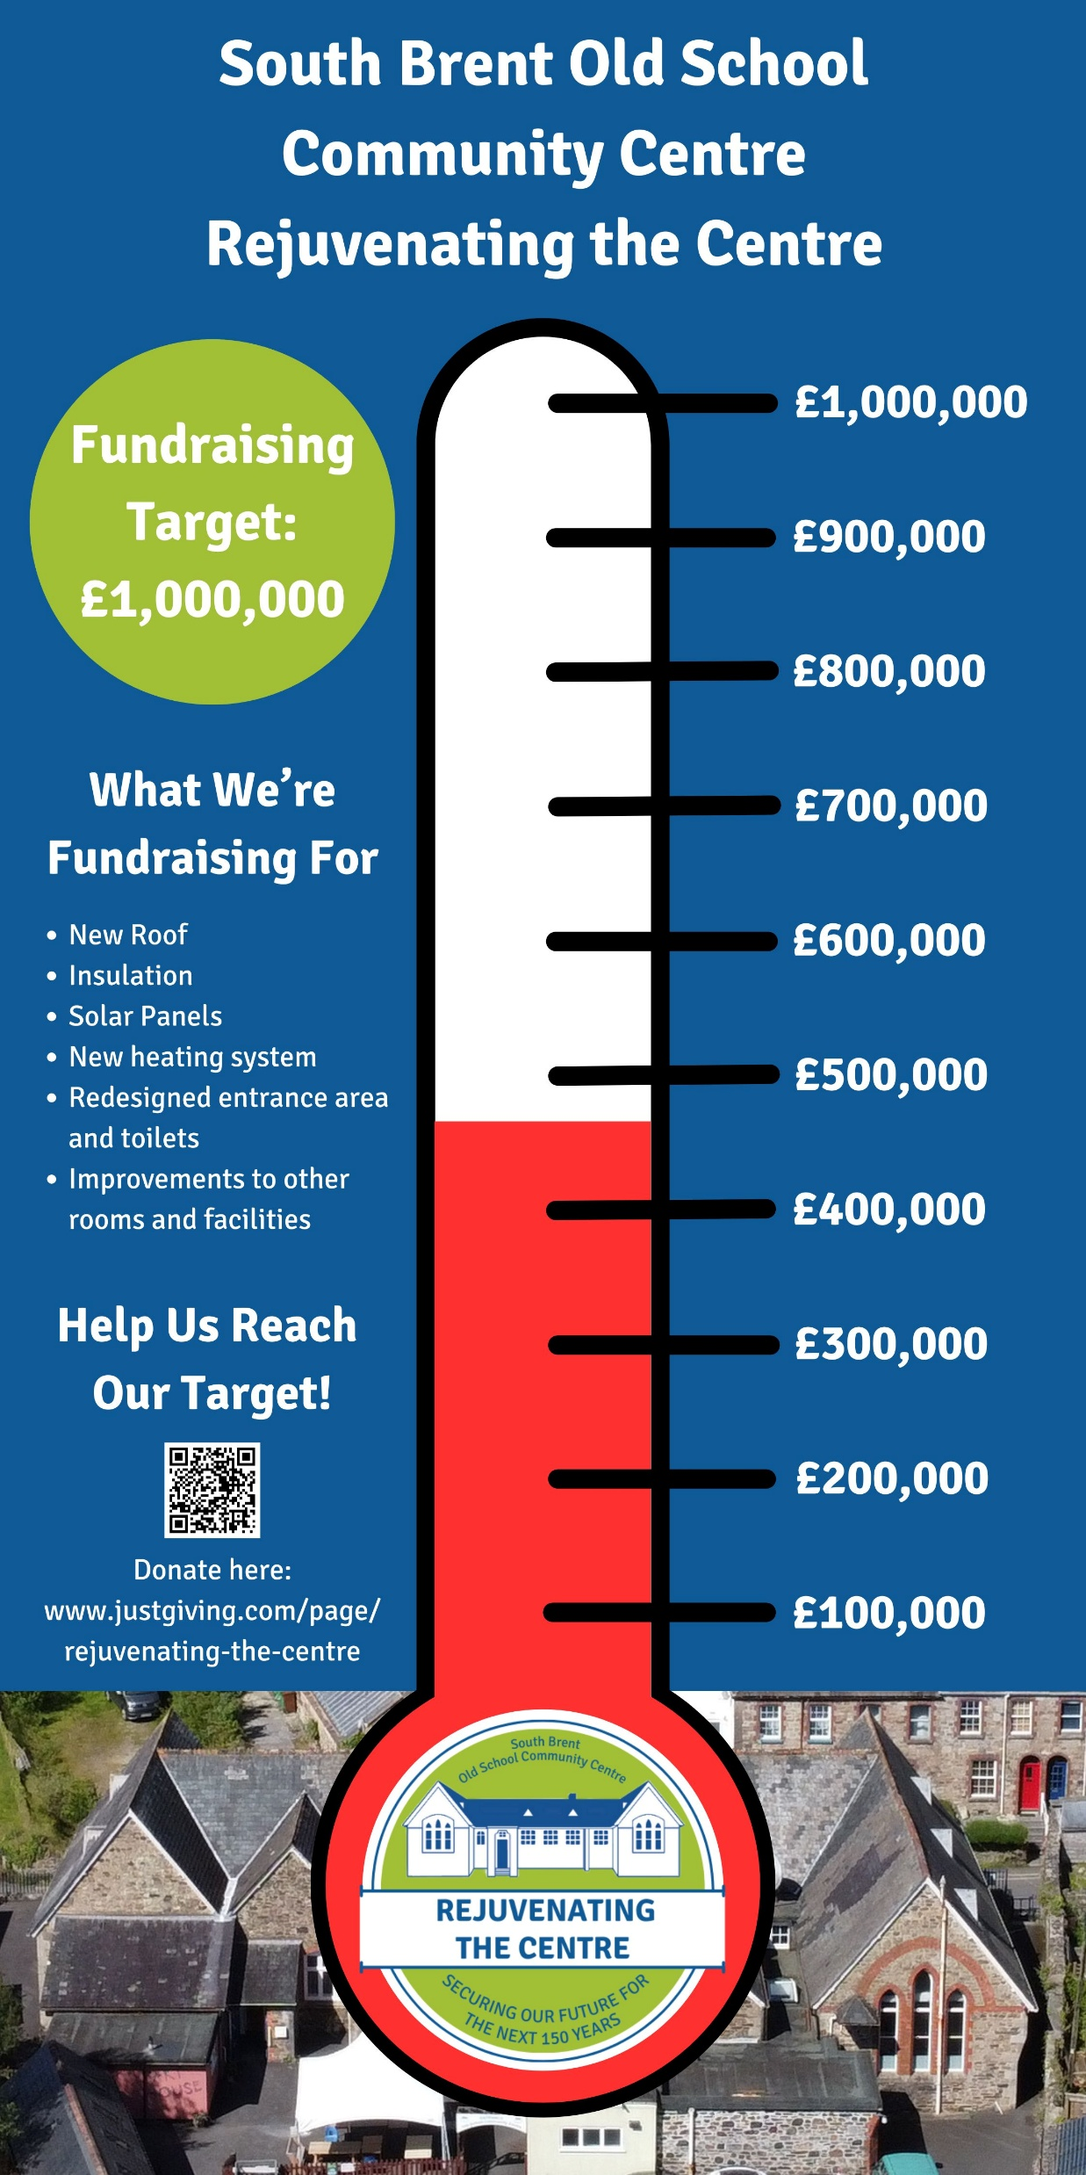

OVER TO YOU

Slide 30
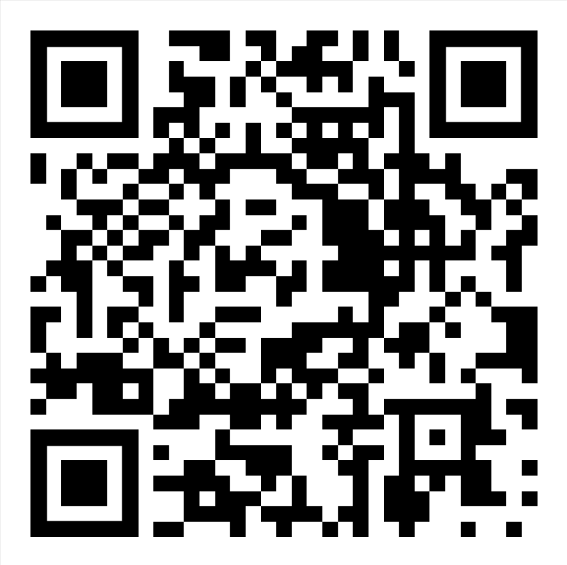
NOW: NEXT STEPS...
Please join us for food & conversation
View the boards and information
Give us your thoughts on next steps for fundraising
Buy a slate or two...or consider more…….
Back for the AGM at 8.30

